Slide 1

World Workplace Insider Tips for Capital Chapter Attendees
September 12, 2019

Slide 2

Contents
Introduction
Make a Plan
Reservations
Tips for Education and Networking
Capital Chapter & World Workplace Resources

Slide 3
Introduction
World Workplace is the premier professional development event for facility managers and related professionals.
Chapter leaders have put together the following information to help first-timers as well as repeat attendees maximize their World Workplace experience.
We hope you find it helpful and see you in Phoenix!
Your Capital Chapter Executive Committee

Slide 4
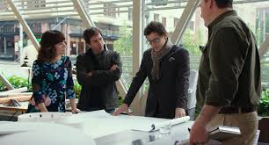
Make a Plan Before You Go
Develop a list of goals you and your team want to achieve from attending World Workplace
  Consider Education, Networking & Contacts, Social, and Business opportunities
  Inform yourself about what opportunities are offered in each of these areas
    Review the IFMA World Workplace site
    Consider IFMA’s 7 Reasons to attend
    Talk to Chapter peers who have attended (see contact info on the last slide)
  Review your goals with your team before you go to manage expectations for your trip
    The WWP schedule is packed and many events are held at the same time as other events so be strategic and realistic about what you and others can attend so that you successfully balance your personal goals with those of your organization

Slide 5
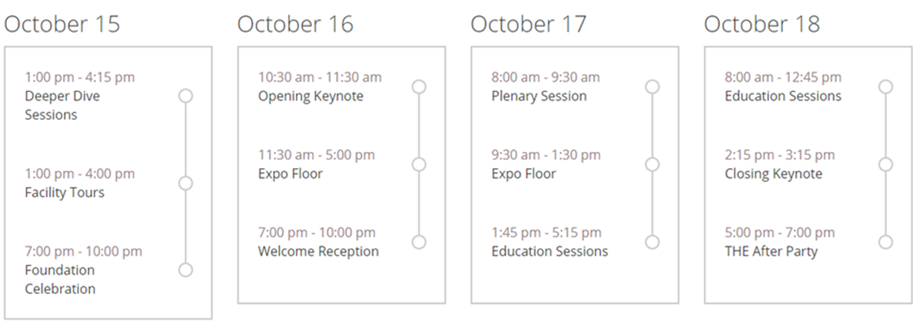
Make Your Reservations ASAP
Tue
Wed
Thu
Fri
  Arrival/Departure: based on your plan, decide when is best for you. The opening Keynote is Wed AM and the last educational session ends just after noon Friday. Many attendees arrive Tuesday afternoon or evening and leave Friday. You may pick up registration materials from 7AM-5PM from Tuesday on.
  Hotels: IFMA hotel blocks go fast but AirBNB and others offer reasonable alternatives to the hotels on the web site.
  Restaurants: if you’re planning on wining and dining anyone during your stay—especially a large group, make reservations asap, preferably before you leave.
  Special Events: Golf , Tours, “Deep Dive” sessions, and Foundation Gala are all extra (sign up when you register for WWP). These fill up quickly, so don’t delay if you want to participate.
  Education: classes are held before WWP starts and offer traditional classroom instruction. Classes are a great way to meet people and learn! The Conference sessions are all from Thursday afternoon through Friday morning.
  Expo Floor: is only open Wed & Thu as indicated above; plan your visits to ensure you see everyone.

Slide 6

Tips for Educational Sessions
Identify seminars that you want to attend:
  Review the sessions & speakers before arrival
  Align your schedule with your goals
  Mark or highlight selected sessions in your guide for quick reference (a printed copy will be provided in your registration package in Phoenix)
  Keep your session guide handy so you can get easily from session to session
    there’s only about 15 minutes between sessions and walking distances can be considerable
  Make notes from sessions while the information is still fresh in your mind
Dress is Business Casual; wear comfortable walking shoes!

Slide 7
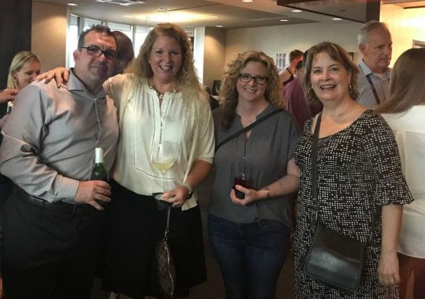
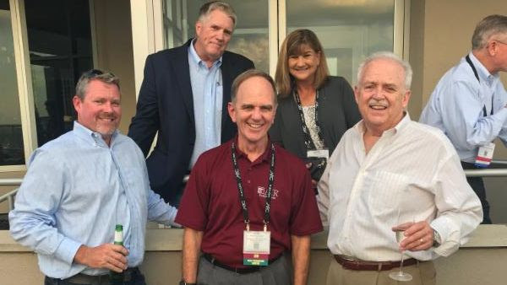
Tips for Networking
Visit the Capital Chapter web site for information about our Wednesday evening Happy Hour at The Park, 3 S. 2nd Street
Identify vendors and/or products you want to see based on your goals and the Exhibitor list in your WWP Guide and on the WWP web site.
Review exhibitors and map vendor locations on the floor ahead of time
Bring plenty of business cards and keep them on hand at all times during your stay
  Exhibitors scan badges but you will want to hand out business cards to peers at networking events throughout the week

Slide 8
World Workplace Resources
Questions? Please ask us. We will tap our collective World Workplace experience to help you get the most from your visit
  Send us an e-mail with your questions to staff@ifmacap.org or
  Call 703-691-4362
  Check out these sites for more information:
    https://worldworkplace.ifma.org/

